Slide 1
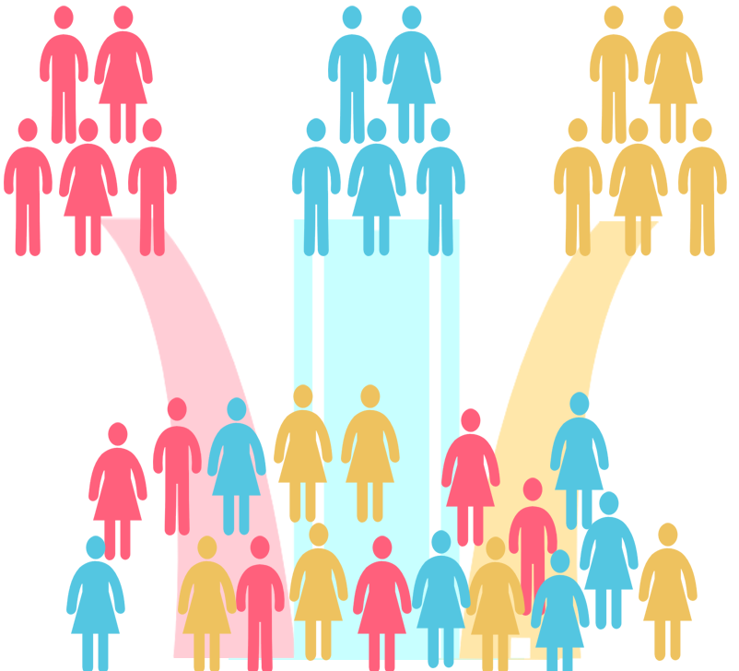

Title: Customer Segmentation
Presented By
Kaustubh Maheshgauri

Slide 2
Problem Statement
The problem we aim to solve is customer segmentation, wherein we apply clustering techniques to group customers based on their financial needs, preferences, or behavior. By dividing customers into distinct segments, we can unlock valuable insights and enable targeted marketing or personalized services for each group.

Slide 3
Objectives:
Clustering techniques used for customer segmentation:
K-means clustering
Hierarchical clustering

Slide 4
Importance of Customer Segmentation
Customer segmentation plays a pivotal role in optimizing business strategies and enhancing customer experiences. It allows organizations to:
Tailor Marketing Efforts
Optimize Product Development:
Improve Customer Retention
Data Description:
Demographics customer attributes:
Customer ID
Gender
Age
Annual Income (k$)
Spending Score (1-100)

Slide 5
Preprocessing Steps:
To ensure accurate and reliable results, we performed the following preprocessing steps on the customer dataset:
Data Cleaning
Handling Missing Data
Addressing Inconsistent Data
Feature Selection
Data Scaling
Data Transformation
Data Splitting

Slide 6
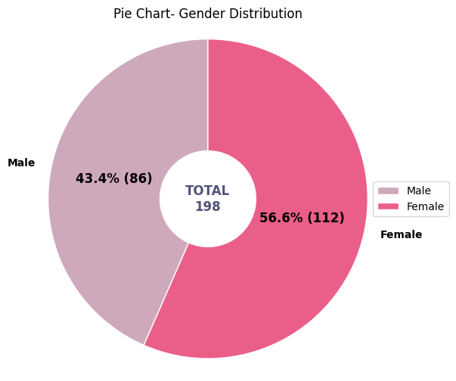
Data Exploration and Visualization
Chart 1:
Distribution of Gender

Slide 7
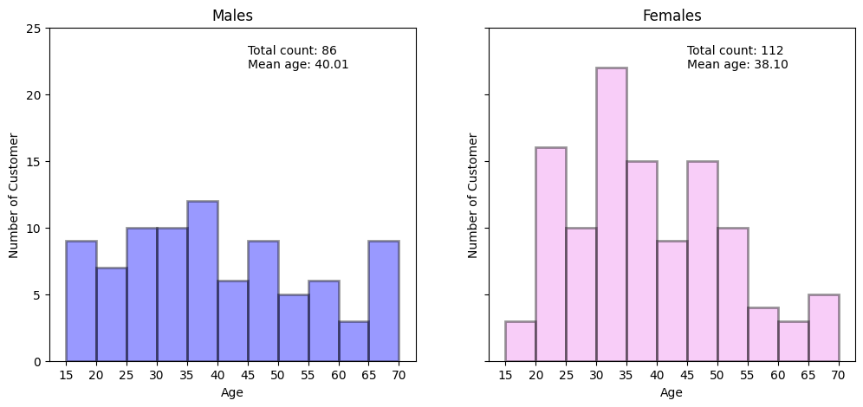
Chart 2: Age Distribution

Slide 8
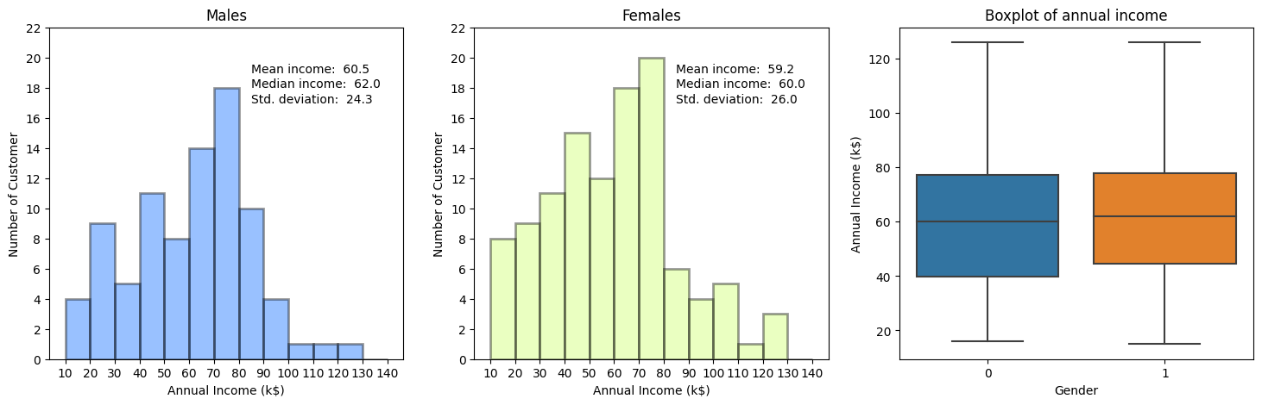
Annual Income Distribution

Slide 9
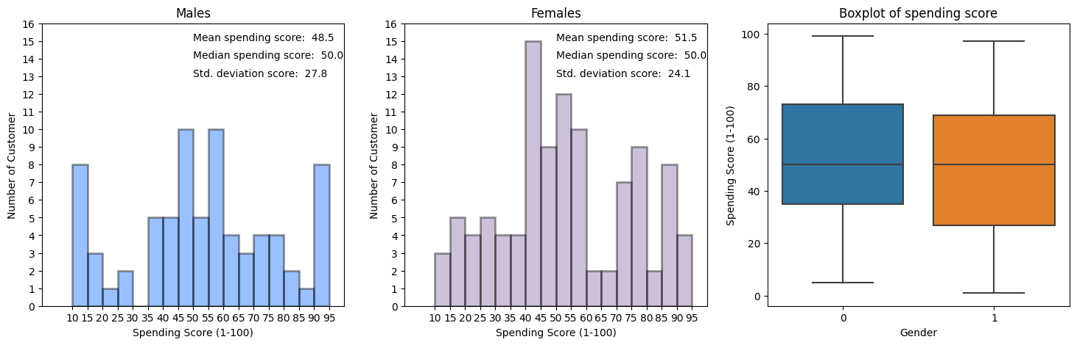
Spending Score Distribution

Slide 10
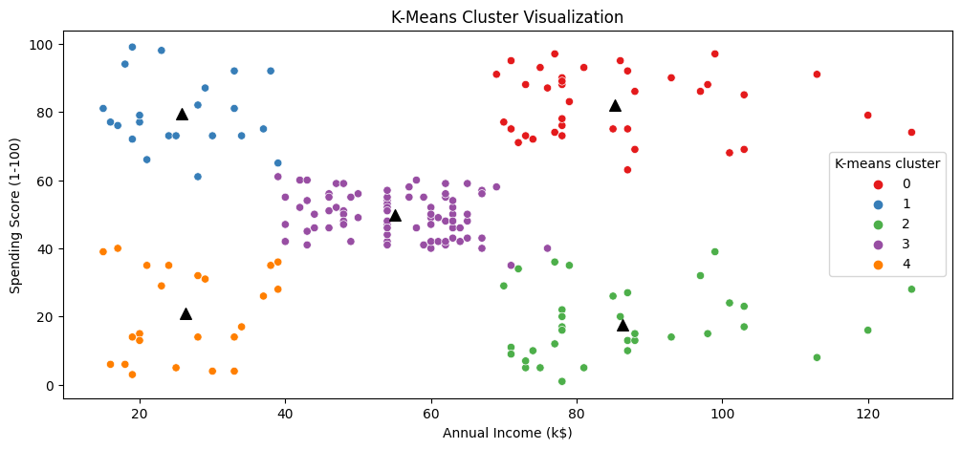
Patterns and Trends

Slide 11
Feature Selection Process
Data preprocessing
Feature ranking or scoring
Feature selection methods: Once we have ranked or scored the features, we can apply feature selection methods to choose the desired subset.
Filter methods
Wrapper methods
Evaluation and validation

Slide 12
Selected Features
Gender
Age
Annual Income (k$)
Spending Score (1-100)

Slide 13
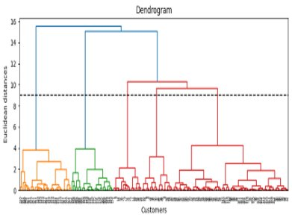
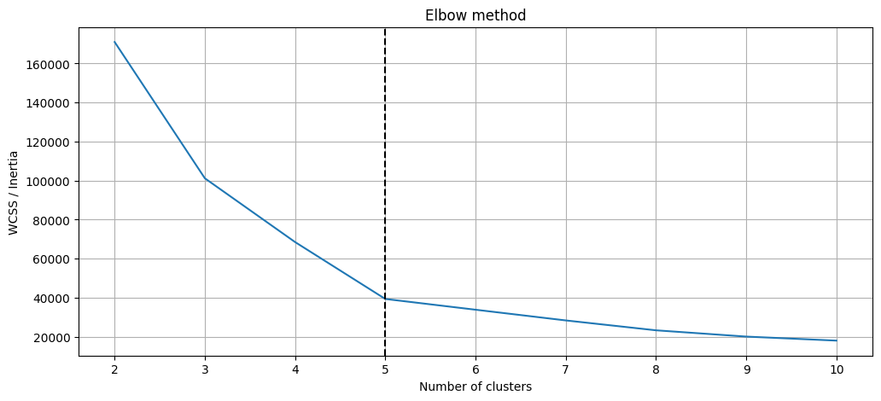
Model Selection
K-Means Model Evaluation :
Hierarchical Model
Evaluation :

Slide 14
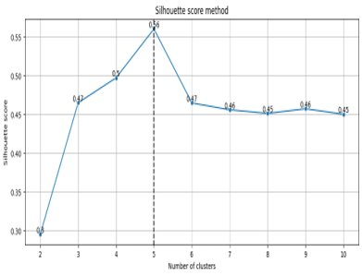
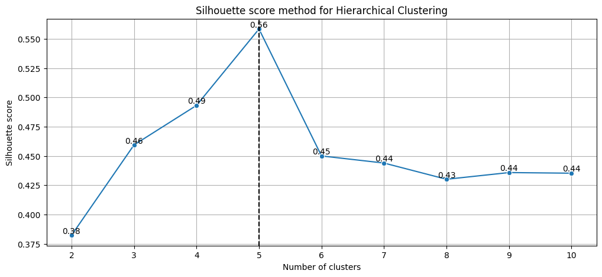
Model Validation
K-Means:
Hierarchical:

Slide 15
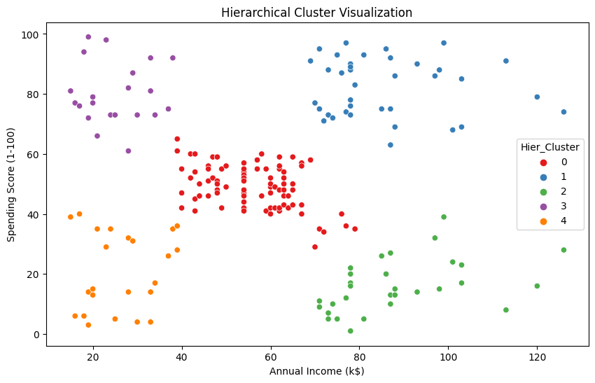
Model Results and Performance Comparison

Slide 16
Limitations and Weaknesses of Models
K-means Clustering:
Assumption of equal cluster sizes and spherical clusters
Sensitivity to initialization
Difficulty handling categorical data
Impact of outliers
Hierarchical Clustering:
Computational complexity
Difficulty handling non-flat cluster structures
Determining the optimal number of clusters

Slide 17
Conclusion:
Project Summary:
Problem: The goal of this project was to segment customers based on their financial needs, preferences, or behavior using clustering techniques.
Dataset: The dataset contained customer attributes such as gender, age, annual income, and spending score.
Results and Implications:
K-Means Clustering and Hierarchical Clustering, successfully segmented customers into distinct clusters.
Enabling targeted marketing and personalized services for each group.
Performance evaluated : Inertia, silhouette score, and cophenetic correlation coefficient.

Slide 18
Implications of Results:
Development of tailored marketing strategies, product offerings, and customer retention initiatives.
Improvement in customer satisfaction and increased profitability.
Future Work:
Experiment with clustering algorithms (e.g., Gaussian Mixture Models, DBSCAN) for improved results.
Use additional features and external data to enhance customer segmentation accuracy and granularity.
Integrate predictive modeling to anticipate future customer behavior and preferences.
Continuously evaluate and update customer segmentation as business and customer landscape evolve.
Leverage clustering techniques for valuable customer insights and informed decision-making.
Drive growth and enhance customer experience using clustering and segmentation.

Slide 19
sources or references
https://www.kaggle.com/datasets/vjchoudhary7/customer-segmentation-tutorial-in-python
https://pandas.pydata.org/docs/reference
https://numpy.org/doc/stable/reference
https://matplotlib.org/stable/index.html
https://seaborn.pydata.org
https://docs.scipy.org/doc/scipy/tutorial/index.html
https://scikit-learn.org/stable/modules/generated/sklearn.cluster.KMeans.html

Slide 20
https://scikit-learn.org/stable/modules/generated/sklearn.metrics.silhouette_score.html
https://plotly.com/python-api-reference/generated/plotly.io.html
https://docs.scipy.org/doc/scipy/reference/generated/scipy.stats.pearsonr.html
https://docs.scipy.org/doc/scipy/reference/generated/scipy.spatial.distance.euclidean.html

